Slide 1
Art and Science of Systems Engineering
Notes:
The purpose of the next two lectures is to provide a background on why good system engineering is important, the characteristics of good systems engineering and good systems engineers and some of the aspects of working as a systems engineer in a team.

Slide 2
The first part of this briefing is based on the monograph titled “Art and Science of Systems Engineering” by Ryschkewitsch, Schaible and Larson
Notes:
Mike Ryschkewitsch is the Chief Engieer of NASA and responsible for the re-writing of the NASA Systems Engineering Handbok. MikeR as he is known, has a wide depth experience from work at the Goddard Space Flight Center. His concern in rewriting the Handbook was that it was too process focused. He believes that good systems cannot be engineered by following a cookbook approach but rather involve detailed engineering focused on understanding the complex interactions between components in the system.

Slide 3
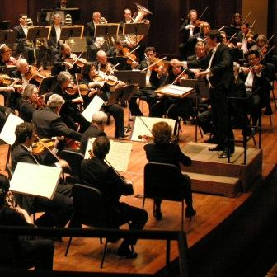
The Piccolo Theory – The role of the conductor is to orchestrate individual efforts. It’s not the conductors job to play the piccolo.
But the conductor must really understand how the piccolo relates to all of the other instruments and to the total performance

Slide 4
The Piccolo Theory
Originally defined by Chris Kraft regarding flight directors
  A flight director doesn’t need to be able to do the jobs of all of the team members but needs to understand the roles and relationships between the team members and needs to have the “BIG Picture”
Really is a great analogy for systems engineering
  The systems engineer doesn’t perform detailed component design but needs to understand the roles and relationships between all of the elements of the design and is the one person who needs to be watching out for the “BIG picture”
Notes:
Chris Kraft was the original Mercury and Gemini flight director who then led mission operations during Apollo and then was the head of the Johnson Space Center during the development of the Space Shuttle.

Slide 5
Definition – System Engineering from Mike R
Systems engineering is the art and science of developing an operable system that meets requirements within imposed constraints. This definition is independent of scale, but our discussion here focuses on developing complex systems, such as aircraft, spacecraft, power plants, and computer networks.

Slide 6
A great systems engineer
completely understands and
applies the art of leadership and
has the experience and scar tissue
from trying to earn the badge of
leader from his or her team.
Harold Bell
NASA Headquarters
Once a credible design and
architecture are established,
the systems engineer’s job is
to maintain technical integrity
throughout the complex
system’s very rigorous and
challenging lifecycle phases.
Robert Ryan,
Marshall Space Flight Center
Notes:
Leadership is a key part of Systems Engineering. Integrity is another key part. Robert Ryan was with the Marshall Space Flight Center during its life from its formation until after the International Space Station was on orbit and was head of the famous Structures Laboratory.

Slide 7
Systems engineering is holistic and integrative. It incorporates and balances the contributions of structural, mechanical, electrical, software, systems safety, and power engineers, plus many other, to produce a coherent whole.
Systems engineering is about tradeoffs and compromises, about generalists rather than specialists.
Systems engineering is first and foremost about getting the right design—and then about maintaining and enhancing its technical integrity, as well as managing complexity with good processes to get the design right.
Notes:
Important points – systems engineering is about tradeoffs – discipline or component engineers will want more resources (people, time, money, weight, electrical power, data bandwidth, cpu cycles) to make their component the best possible, but they may be adding capabilities above what is needed. Resources spent adding in capabilities in excess of requirement CAN (not always but most times) reduce the resources necessary to get other components up to meeting their requirements, thus preventing the whole system from succeeding.
Miker strikes an important note here about getting the right design. Getting the right design is the primary job. All the process stuff can help implement the right design choices but process cant help bad design choices.

Slide 8
Systems management provides a framework for problem solving...creative problem solving
for complex systems.
Dinesh Verma,
Stevens Institute of Technology
One of the biggest challenges for a systems engineer of a large complex project is to “bring order from chaos.”
Chris Hardcastle,
Systems Engineering and Integration
Manager, NASA’s Constellation Program,
Johnson Space Center

Slide 9
People who have “systems engineer” in their title, regardless of the modifiers—project, program, flight system, and so on—are responsible for everything.
Gentry Lee,
Jet Propulsion Laboratory
Notes:
Gentry Lee was a legendary systems engineer at the Jet Propulsion Laboratory responsible for pulling together their magnificent deep space probes into working systems. He says it all right here.. As a systems engineer you are responsible for everything working together.

Slide 10
In his 2007 presentation, “Systems Engineering and the ‘Two Cultures’ of Engineering,” Mike Griffin describes how the complexities of today’s aerospace systems and the ways they fail have led to branching within the industry. For our purpose, we divide systems engineering into technical leadership and its ally, systems management.
Technical leadership focuses on a system’s technical design and technical integrity throughout its life cycle
Systems management focuses on managing the complexity associated with having many technical disciplines, multiple organizations, and hundreds or thousands of people engaged in a highly technical activity
Notes:
Mike Griffin was NASA administrator and a very very smart systems engineer. He points out the difference between process (systems management) and technical leadership (getting the right design)

Slide 11
Technical leadership, the art of systems engineering, balances broad technical domain knowledge, engineering instinct, problem solving, creativity, leadership, and communication to develop new missions and systems.
It is the system’s complexity, and severity of its constraints—not just its size—that drives the need for systems engineering.
Systems management is the science of systems engineering. Its focus is on rigorously and efficiently managing the development and operation of complex systems.

Slide 12
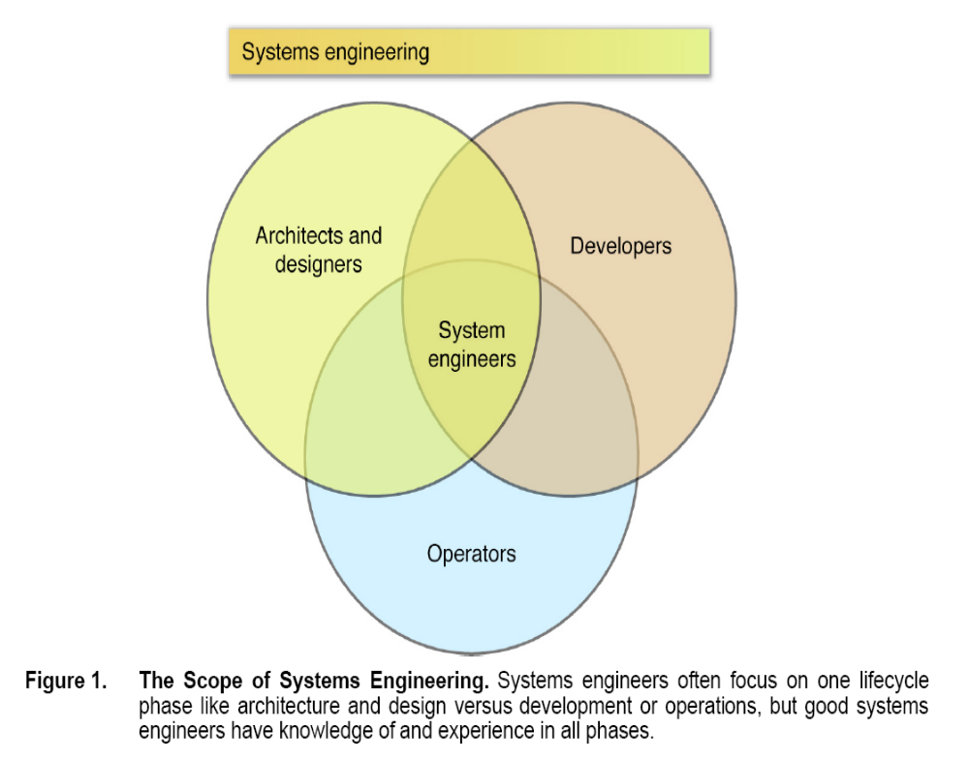
Notes:
With long drawn out development programs it is easy to specialize in one part of the life cycle. It is easy to get focused in the project formulation phase (architects and designers), in the actual development h0ase (generating drawings, code and analysis and building, assembling and testing) in the operations phase. For example in the shuttle program with aa 30 yr operational life, people could spend their entire careers in operations. But to be a systems engineer you need to have experience in all of these phases. Small projects are especially good incubators for systems engineers because there are so few people that everyone gets involved in all disciplines and small projects tend to be more short term in nature so engineers can see all the phases. But systems engineers need to learn about scaling up too. Learning the basics on small projects is good, but there are problems in directly applying small project techniques to large programs.

Slide 13
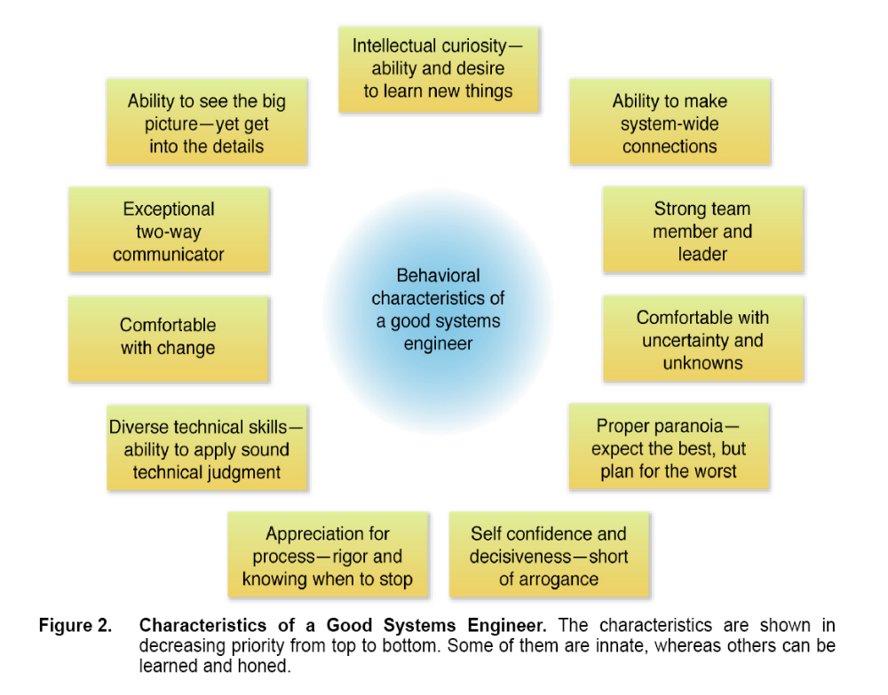

Slide 14
While management and leadership are related and
often treated as the same, their central functions are
different. Managers clearly provide some leadership,
and leaders obviously perform some management.
However, there are unique functions performed by
leaders that are not performed by managers. My
observation over the past forty years...is that we
develop a lot of good managers, but very few leaders.
Let me explain the difference in functions they perform.
• A manager takes care of where you are; a leader
takes you to a new place
• A manager is concerned with doing things right; a
leader is concerned with doing the right things
• A manager deals with complexity; a leader deals with
uncertainty
• A manager creates policies; a leader establishes
principles
• A manager sees and hears what is going on; a leader
hears when there is no sound and sees when there
is no light
• A manager finds answers and solutions; a leader
formulates the questions and identifies the problems
James E. Colvard
Notes:
The italics are mine

Slide 15
The number of changes must decrease with time.
If projects continue to change, they will never get to
the launch pad. This is particularly true with
requirements. While it is undesirable to freeze
them too early, it is much more likely that
requirements will continue to change way too long.
...At some point, the design must be implemented,
at which time “change” is the enemy.
Ken Ledbetter, NASA Headquarters

Slide 16
Commission, not omission. This should be
written on the door of every systems engineer.
There is no excuse for omission. A systems
engineer does not need authority from anyone to
investigate anything. The systems engineer’s
job is the whole space. You go out, you make
decisions. If someone tells you to stop, you use
your communication skills and listen.
Gentry Lee, Jet Propulsion Laboratory

Slide 17
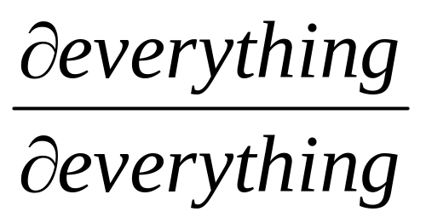
It is not sufficient, systems engineers, to simply know the requirements and say, “Look we met our requirements.” We must go beyond and be able to understand and articulate how much margin we have available in any situation. This gets us back to knowing the partial derivative of
everything with respect to everything!
Gentry Lee, Jet Propulsion Laboratory
A systems engineer must know how much a change in any area affects all the other areas
Notes:
Gentry has a wonderful way of expressing systems engineering in mathematical terms. What he says here is very true. A systems engineer must know how much a change in any area affects all the other areas.. Or in other words the partial derivative of everything with respect to everything !

Slide 18
The Story of Apollo 13
Apollo 13 exploded halfway to the moon setting up one of the most dramatic events in NASA’s history
Why it happened and how it happened is very important for systems engineers to study, even if they don’t work with aerospace systems
In October 1968, when O2 Tank 2 used in Apollo 13 was at North American, it was dropped.
It was only a two-inch drop, and no one could detect any damage, but it seems likely that the jolt loosened the “fill tube” which put liquid oxygen into the tank.
In March 1970, three weeks before the flight, Apollo 13 underwent its Countdown Demonstration Test...which involved loading all the cryo(genics s to feed the fuel cells which provided electricity to the Apollo) .
When the test was over, O2Tank 2 was still 92 percent full, and it wouldn’t de-tank normally—probably because of the loose fill tube.
Because a problem in the fill tube would have no effect on the tank’s operation during flight, the malfunction was not thought to be relevant to flight safety.
Notes:
Big accidents have a tendency to become dominant items in the corporate mindset of organizations. Apollo 13 is that way for NASA. But because it represents an early and major failure in the effort to engineer very complex systems, it is worth examining and Mike R gives an interesting perspective in the next few charts. The fill tube failure didn’t cause a problem inflight but it did cause a problem which started a chain of events that led to the apollo 13 explosion

Slide 19
After three unsuccessful attempts to empty the tank, it was decided to boil off the oxygen by using the internal heater and fan.
This was considered to be the best procedure because it reproduced the way the system would work during flight: heating the liquid oxygen, raising its pressure, converting it to a gas, and expelling it through the valves and pipes into the fuel cells where, in flight, it would react with the hydrogen.
So they turned on the tank’s heater.
Good logic so far
Notes:
Good logic so far

Slide 20
A technician working the night shift on Pad 39A was assigned to keep an eye on the tank temperature gauge and make sure that it did not go over 85 degrees Fahrenheit.
It was not really necessary that a human serve this function, because a safety switch inside the tank would cut off the heaters if the temperature went beyond the safety limit.
And, in reality, the safety margin built into the system meant that the temperatures could go considerably higher than 85 degrees without doing any damage.
But the precautions were part of NASA’s way of ensuring that nothing would go wrong.

Slide 21
After some time, the technician noticed that the temperature had risen to 85 degrees, but all he had been told was that anything in excess of 85 degrees was a problem, so he let the heater run—about eight hours, in all.
No one had told him that the gauge’s limit was 85 degrees.
That’s as high as it could measure.
Thus the technician could not tell that the temperatures inside the tank were actually rising toward a peak of approximately 1,000 degrees Fahrenheit, because the safety switch had failed.

Slide 22
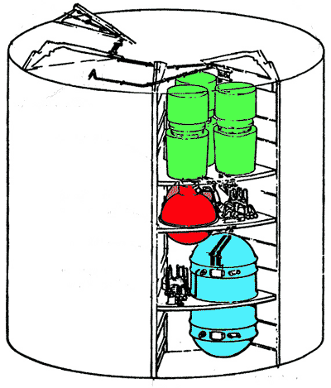
It had failed because of one small but crucial lapse in communication.
Eight years earlier, in 1962, North American had awarded Beech Aircraft a subcontract to build the cryogenics tanks for the service module.
The subcontract specified that the assembly was to use 28-volt D.C. power.
Beech Aircraft in turn gave a small switch manufacturer a
subcontract to supply the thermostatic safety switches, similarly specifying 28 volts.
In 1965, North American instructed Beech to change the tank so that it could use a 65-volt D.C. power supply, the type that
would be used at KSC during checkout.
Beech did so, neglecting, however, to inform its subcontractor to change the power
specification for their thermostatic safety switches.
No one from Beech, North American, or NASA ever noticed this
omission.
Oxygen tank in service
module

Slide 23
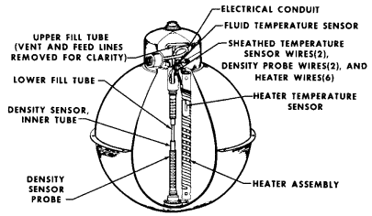
On all the Apollo flights up through 12, the switches had not had to open.
When the tanks were pressurized with cryogens hundreds of degrees below zero, the switches remained cool and closed.
When, for the first time in the history of the cryo tanks, the temperature in the tanks rose high enough to trigger the switch—as O2 Tank 2 emptied—the switch was instantaneously fused shut by the 65-volt surge of power that it had not been designed to handle.
For the eight hours that the heaters remained on, the Teflon insulation on the wires inside the cryo tank baked and cracked open, exposing bare wires.

Slide 24
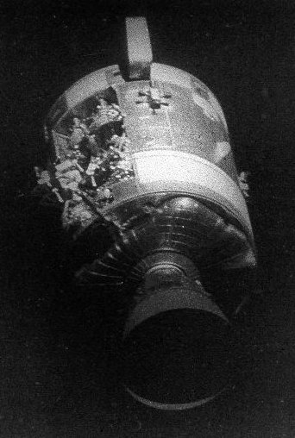
On the evening of April 13...[when the cryo tank was stirred], some minute shift in the position of two of those bare
wires resulted in an electrical short circuit, which in turn ignited the Teflon, heating the liquid oxygen.
About sixteen seconds later, the pressure in the O2 Tank 2 began to rise.
The Teflon materials burned up toward the dome of the tank, where a larger amount of Teflon was concentrated, and the fire within the tank, fed by the liquid oxygen it was
heating, grew fierce.
In the final four seconds of this sequence, the pressure exceeded the limits of the tank in about eleven microseconds, slamming shut the reactant valves on Fuel Cell 1 and Fuel Cell 3.
Then the Teflon insulation between the inner and outer shells of the tank caught fire, as did the Mylar lining in the interior of the service module.
Service module photographed
by Apollo 13 crew after its
jettison prior to re-entry

Slide 25
The resulting gases blew out one of the panels in the service module.
That explosion also probably broke a small line that fed a pressure sensor on the outside of the O2 Tank 1, opening a small leak that bled down other tanks.
Once the service module panel blew out...
This true story is rich in content relevant to systems engineering.
It includes examples of
design,
changes in requirements and their impact,
technical data management,
overall technical integrity,
communications and decisions,
transitions (from one contract to another, for example),
interfaces,
anomaly response,
and processes, to name a few.
It is worth taking a moment to think about the complexities of technical design, organization, and process that this single example demonstrates.
Our job as systems engineers is to manage this complexity!

Slide 26
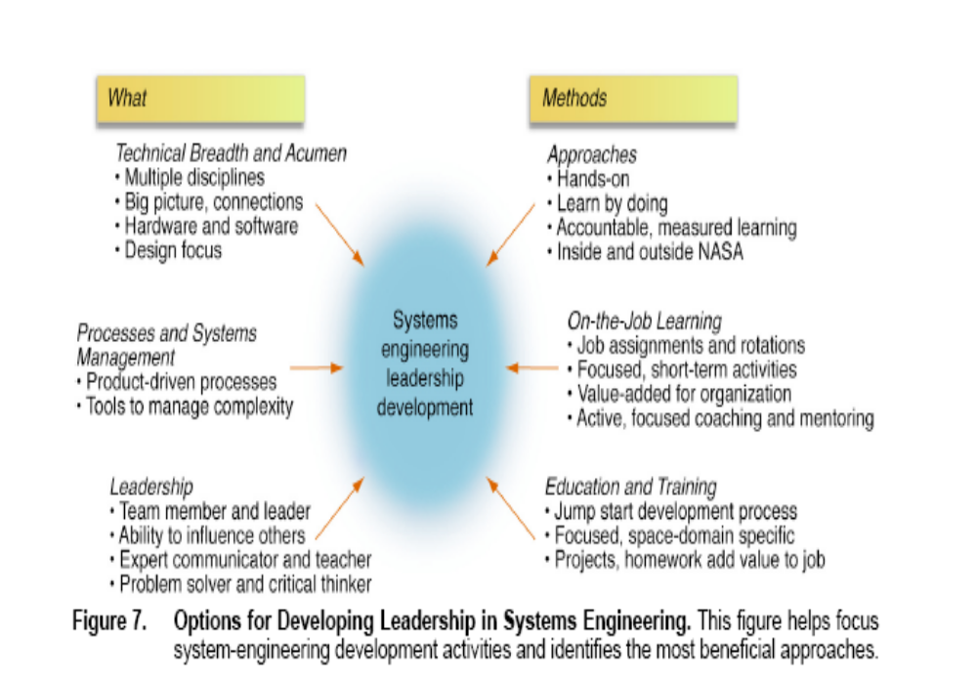

Slide 27
Attitudes towards systems engineering

Slide 28
Fascinating…
One of the most fascinating things to me in the field of systems engineering is the attitude of people towards it
Originally I just thought it was me (or them) when I would have arguments about the role of systems engineering in programs
Over time I have come to realize several truths
  The dichotomy between systems thinkers and component thinkers has always existed
  It is about how our brains are “wired” and shaped by experience
  People will continue to engage in component thinking even when faced with repeated failures due to lack of systems thinking

Slide 29
Examples from Secrets of Apollo by Johnson
Repeated Ranger failures – it took 6 failures to get good systems engineering into Ranger
  P 102 Board found “Pride in accomplishment is not a self-sufficient safeguard when undertaking large scale projects of national significance…”
  In other words, its not enough that component engineers are good people trying hard with good motivation to engineer a large successful system
Surveyor
  P 105 “many groups “showed a surprising lack of information or interest” about the impact their product had on adjacent products or the spacecraft as a whole”
ELDO
  Dec 67 – electrical interface problem between second stage and ground
  Dec 68 – electrical problem between satellite and third stage
  Jul 69 – same electrical problem between satellite and third stage
  Jun 70 – electrical connector fails between satellite and third stage
  Nov 71 – electrical fault in third stage

Slide 30
What is surprising is how common the reactions are
When confronted with systems problems most component oriented thinkers do NOT put strong systems engineering into place
Instead they put
  Coordinating panels with no limited or no authority – Ranger, Surveyor, ELDO, Mercury
  Limited fixes, Some additional testing
  Keep doing what they’ve been doing – No overhaul of practices
Einstein defined stupidity as “continuing to do the same thing expecting a different result “

Slide 31
Was this all in the past before we appreciated systems engineering?
Recent NASA Mishap reports that all cited lack of systems engineering
  DART – 2006
  Columbia Accident Investigation Board – 2003
  Helios - 2003
  Mars Climate Orbiter – 1999
  Mars Polar Lander - 1999
  DC-XA 1996
What is interesting about these cases is that most of them had racked up significant accomplishments and were looking good just before they ran into a wall caused by lack of total systems thinking

Slide 32
Successful programs
Strong systems engineering focus
  International Space Station
  X-38
  Shuttle Return to flight
  Hubble Repair
  New Mission Control Center
Some of these had less commitment to formal methods and more commitment to rapid spiral methodology but all were heavily oriented towards total systems thinking and test and measurement
In all of these there was considerable tension between component developers and the systems thinkers

Slide 33
Research at NASA on systems personality
Research at JPL performed Myers-Briggs personality profiles on their top 25 systems engineers and found them to largely be
  Extraverts E
  Intuitive N
  Thinking T
  Perceivers P
Larger study throughout NASA showed successful systems engineers to be Intuitive Thinkers (NT)
Most engineers and scientists are NOT ENTPs – largely ISTJ (Intravert, Sensing, Thinking, Judging).
No wonder we fight all the time !
Does this mean you have to be an ENTP to be a systems engineer ?
  NO
  It means that to be successful at systems engineering, if you are not naturally a systems thinker that you must work to develop some undeveloped parts of your personality
And if you are a systems thinker, it means you have to carry the burden of explaining yourself better

Slide 34
Component
Thinking
Because most people are not strong systems thinkers, we tend to set up systems engineering efforts to fail
  We often set component projects up and running before a systems engineering organization is in place
    This puts systems engineering in catch up mode from the start
      Examples – shuttle, constellation
  There is a tendency for program managers to view component organizations as doing “the real work of delivering the hardware” and the systems engineering organizations as “overhead”
    This can be very frustrating as the work of integrating a system is as vital as delivering the parts
As systems engineers the burden of explaining the importance of systems engineering falls on us
  Case studies provide a very good way to explain it because you can point to them without criticizing the people you are working with directly

